Slide 1
Gateway 100R and Annual Financial Report (AFR)
2014 Overview and Update

Slide 2

Indiana Gateway for Government Units
Gateway Public Website
  https://gateway.ifionline.org/

Slide 3
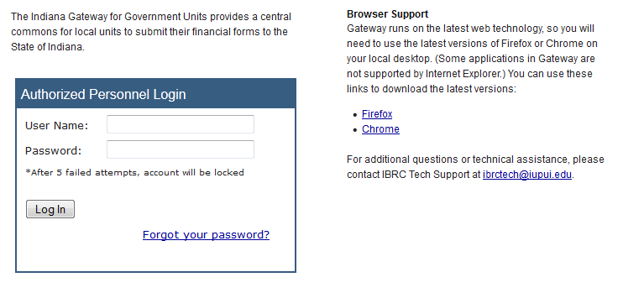
Indiana Gateway for Government Units
Gateway Login Screen
  https://gateway.ifionline.org/login.aspx

Slide 4
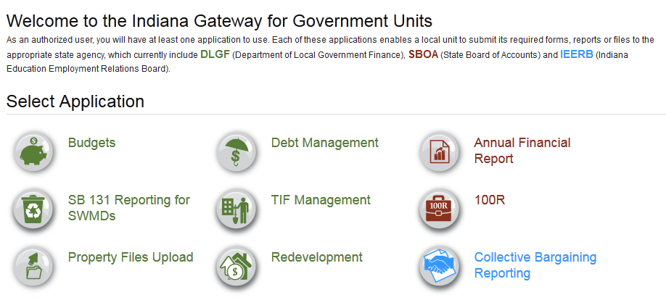
Indiana Gateway for Government Units
Gateway Home Screen
  Applications are available for multiple agencies.

Slide 5
Certified Report of Names, Addresses, Duties and Compensation of Public Employees (Form 100R)
Per IC 5-11-13
  Must be filed with the State Examiner.
  DLGF may not approve the budget of a unit until it is filed.
  Must be filed electronically via the State Gateway.
  Due January 31 each year.
  Must indicate whether the unit offers a health plan, a pension, and other benefits to full-time and part-time employees.

Slide 6
Certified Report of Names, Addresses, Duties and Compensation of Public Employees (Form 100R)
Per IC 5-11-13-1.1
  Must indicate whether the unit has implemented a nepotism policy (IC 36-1-20.2) and a contracting policy (IC 36-1-21). Do NOT send copies of these policies or the 100R to SBOA.
  New for 2014. A PDF file of the nepotism and contracting policies must be uploaded to Gateway.

Slide 7
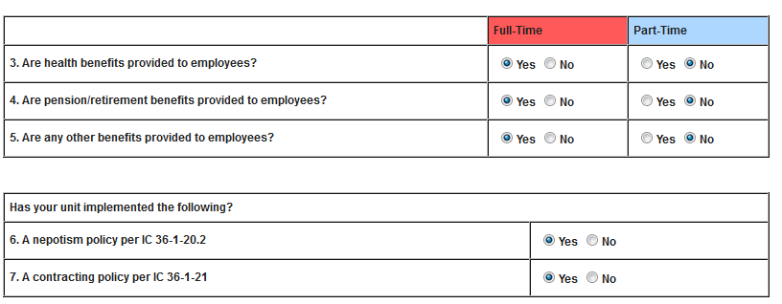
Certified Report of Names, Addresses, Duties and Compensation of Public Employees (Form 100R)
Note: Buttons will be added to this screen to upload your nepotism and contracting policies.

Slide 8
Certified Report of Names, Addresses, Duties and Compensation of Public Employees (Form 100R)
What if I didn’t have a nepotism or contracting policy when I filed the 2013 100R in January 2014, but I do now?
  So that you will be able to get your budget approved, you will need to contact us by email at annualreports@sboa.in.gov and ask us to unlock your 2013 100R. You can then make changes and re-submit it.

Slide 9
Certified Report of Names, Addresses, Duties and Compensation of Public Employees (Form 100R)
Who to Report
  Report ALL people employed by the unit for the previous year. This includes part time, temporary, and seasonal employees. If a W2 is issued, that person should be listed on the Gateway 100R. IRS Publication 15 has guidelines for determining if someone is an employee or a contractor. Elected officials including board members should be included.

Slide 10
Certified Report of Names, Addresses, Duties and Compensation of Public Employees (Form 100R)
What to Report
  Report the total compensation paid to the employee during the previous year. Use IRS Publication 15 as a guideline as to what to include as compensation. For specific questions, check the user guide and consult your tax professional.

Slide 11
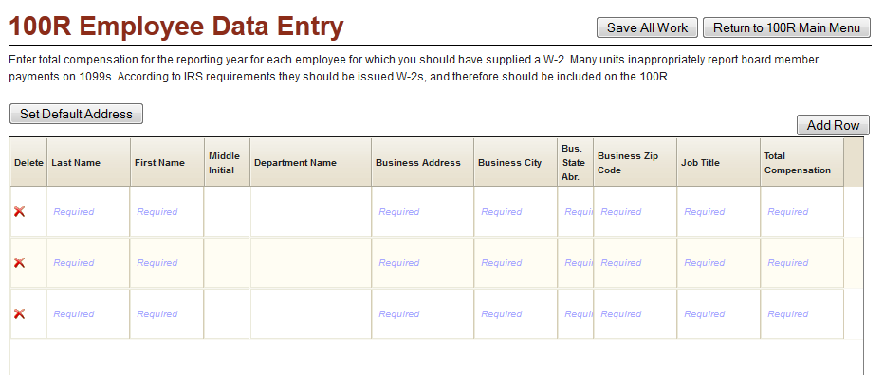
Certified Report of Names, Addresses, Duties and Compensation of Public Employees (Form 100R)

Slide 12
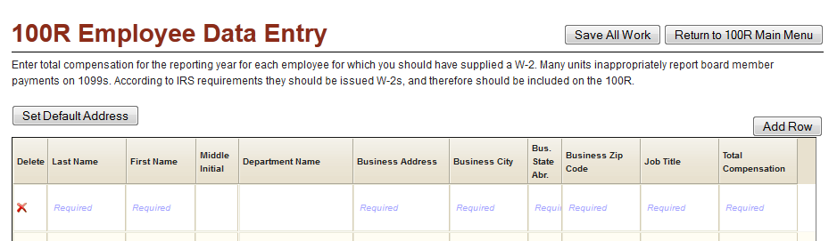
Certified Report of Names, Addresses, Duties and Compensation of Public Employees (Form 100R)
  Ability to auto fill address fields.

Slide 13
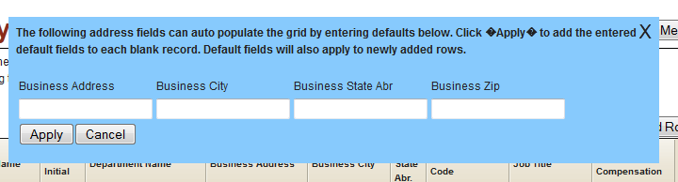
Certified Report of Names, Addresses, Duties and Compensation of Public Employees (Form 100R)
  Ability to auto fill address fields.

Slide 14
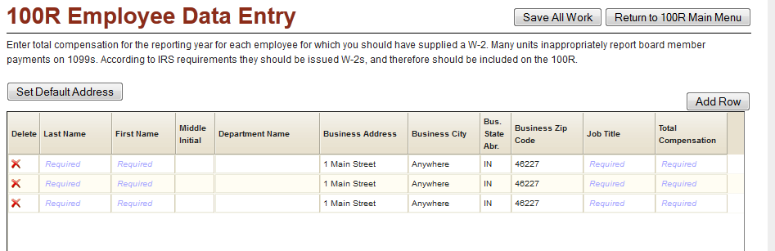
Certified Report of Names, Addresses, Duties and Compensation of Public Employees (Form 100R)
  Ability to auto fill address fields.

Slide 15
Certified Report of Names, Addresses, Duties and Compensation of Public Employees (Form 100R)
Helpful Hints
  Tab or click in a cell to go to the next cell in a row.
  Enter one row at a time. Press the Enter key when you are finished entering a row.
  Correct any errors on a row before starting the next row.
  Enter something in all cells marked “Required” or the row will not be saved.

Slide 16
Certified Report of Names, Addresses, Duties and Compensation of Public Employees (Form 100R)
Helpful Hints
  Avoid using double quotes in a cell.
  Do not enter a dollar sign or commas in the Total Compensation cell.
  Click the Save All Work Button to save changes.
  You may sort rows within the grid by clicking on the column heading.
  For best results, use the most recent version of Internet Explorer, Chrome or Firefox.

Slide 17
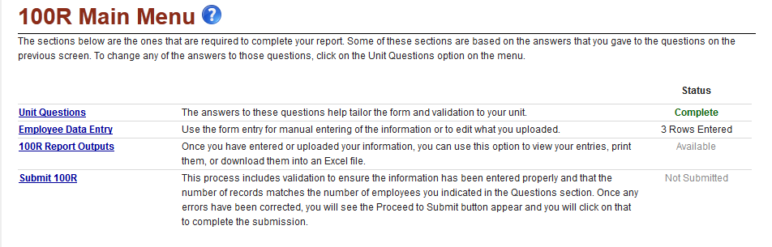
Certified Report of Names, Addresses, Duties and Compensation of Public Employees (Form 100R)
Submit 100R and Attestation Statement
  Don’t forget to submit. Your form is not filed until you submit it.
  An Attestation Statement is part of the submission process.

Slide 18
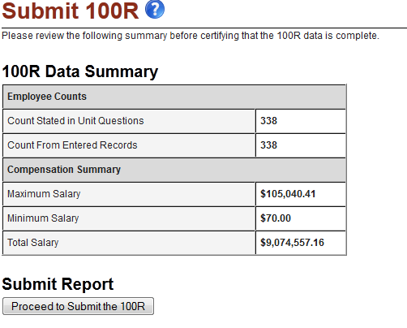
Certified Report of Names, Addresses, Duties and Compensation of Public Employees (Form 100R)
  Submit 100R and Attestation Statement

Slide 19
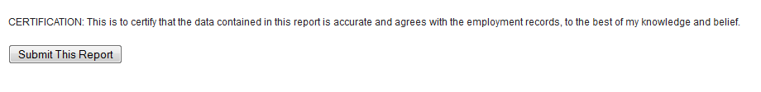
Certified Report of Names, Addresses, Duties and Compensation of Public Employees (Form 100R)
  Submit 100R and Attestation Statement

Slide 20
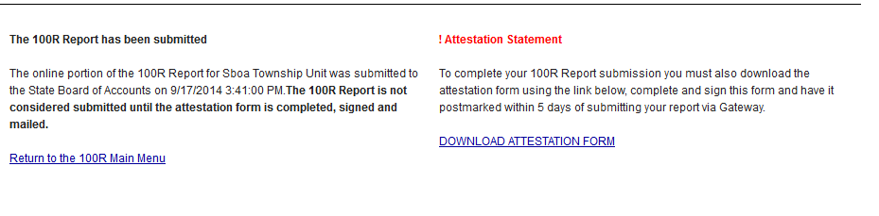
Certified Report of Names, Addresses, Duties and Compensation of Public Employees (Form 100R)
  Submit 100R and Attestation Statement

Slide 21
Certified Report of Names, Addresses, Duties and Compensation of Public Employees (Form 100R)
Attestation Statement
  Certifies that the data is accurate to the best of your knowledge and belief.
  Must be signed by the official.
  Must be mailed within 5 days of submitting on Gateway.
  If you re-submit your 100R on Gateway, you must print, sign and mail a new attestation form.

Slide 22
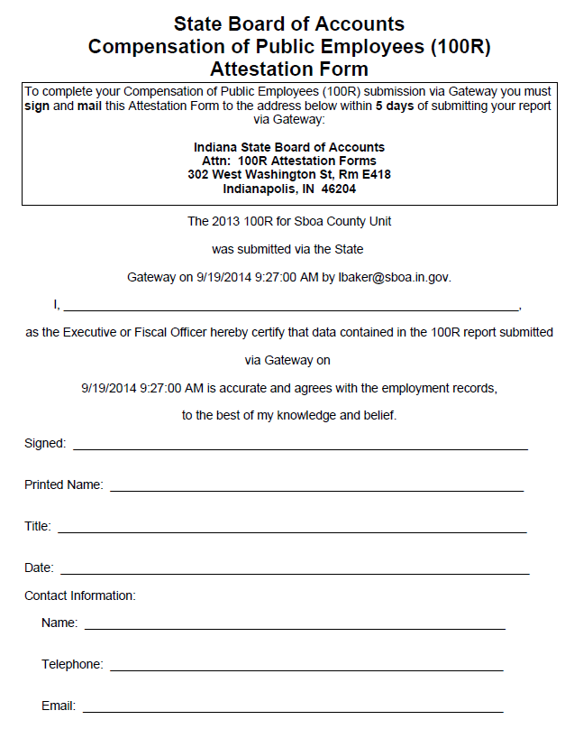

Slide 23

Certified Report of Names, Addresses, Duties and Compensation of Public Employees (Form 100R)
How can I get help?
  User Guide

Slide 24
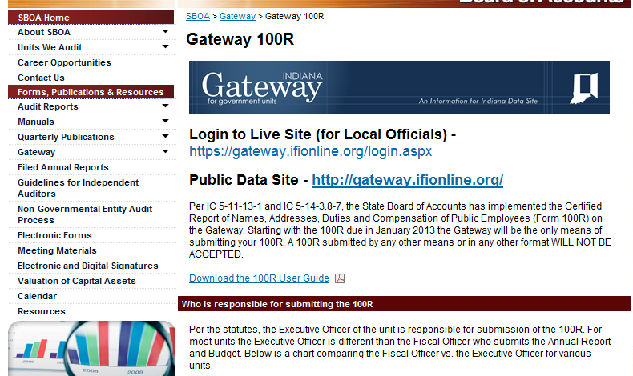
Certified Report of Names, Addresses, Duties and Compensation of Public Employees (Form 100R)
How can I get help?
  SBOA Web site at www.in.gov/sboa

Slide 25
Certified Report of Names, Addresses, Duties and Compensation of Public Employees (Form 100R)
How can I get help?
  Email the SBOA Help Desk at: annualreports@sboa.in.gov
  Email IBRC Technical Support at: ibrctech@iupui.edu

Slide 26
Certified Report of Names, Addresses, Duties and Compensation of Public Employees (Form 100R)
Questions?

Slide 27
Annual Financial Report (AFR)
Per IC 5-11-1-4
  Must be filed with the State Examiner.
  DLGF may not approve the budget of a unit until it is filed.
  Must be filed electronically via the State Gateway.
  Due 60 days after the year end which will be March 1, 2015.

Slide 28
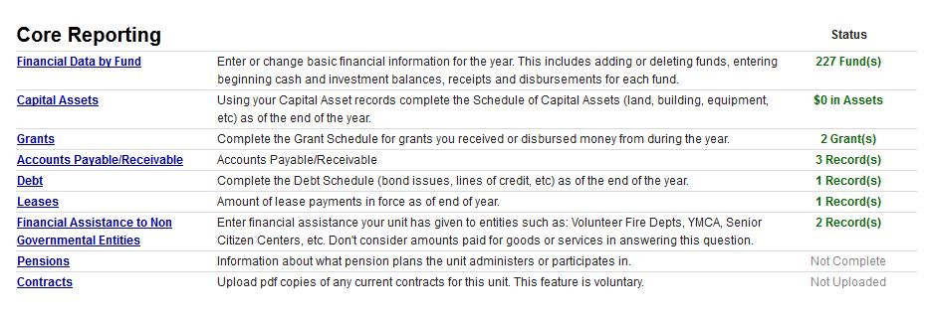
Annual Financial Report (AFR)
New for 2014
  Changes to Pension screen due to changes in accounting standards (GASB 67 and GASB 68).

Slide 29
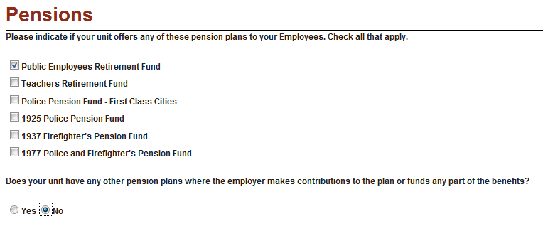
Annual Financial Report (AFR)
New for 2014
  Changes to Pension screen.
    If you have only have PERF or no other plan, the changes will not affect you.
    Any other pension plans are entered on the next screens.

Slide 30
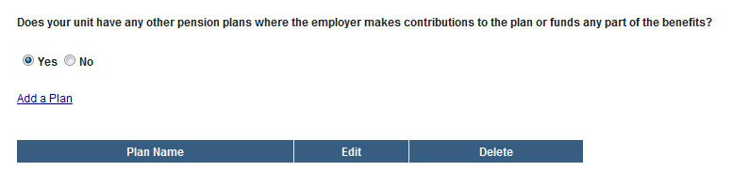
Annual Financial Report (AFR)
New for 2014
  Changes to Pension screen.
    If you have other pension plans, answer YES and click Add a Plan.
    Do not add PERF or deferred compensation plans here.

Slide 31
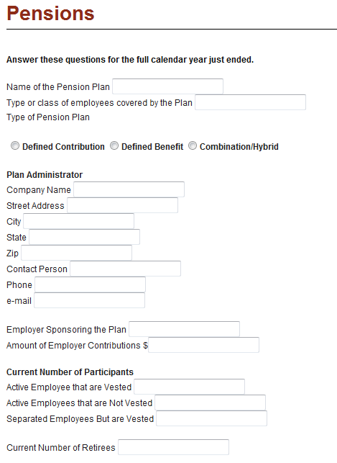
Annual Financial Report (AFR)
New for 2014
  Changes to Pension screen.
    If it is a Defined Contribution Plan, there is no further data entry. Otherwise, you will be asked about the actuarial valuation for the plan on the next screens. This screen has not changed.

Slide 32
Annual Financial Report (AFR)
New for 2014
  Changes to Pension screen.
    If you have a Defined Benefit or Combination plan, you will be asked if an actuarial valuation has been done for the plan.
    If there is an actuarial valuation, you will enter the actuarial assumptions, contribution rates and other information from your actuary.
    This is the screen that will be changing. I do not have all of the changes or a screen to show you at this time.

Slide 33
Annual Financial Report (AFR)
New for 2014
  Schedule of Officials
    There will be some fields that are now required to be completed and can’t be left blank.
    They are the Primary Contact, Office Address, Office Phone Number and Office Email Address.

Slide 34
Annual Financial Report (AFR)
New for 2014
  New Funds for Cities/Towns
    101157 Food and Beverage Tax has been added for Cities and Towns to use. This was left out in error.
    102255 Heritage Barn Public Safety-Police
    102256 Heritage Barn Public Safety-Fire
    Check our website at www.in.gov/sboa for updated fund tables.

Slide 35
Annual Financial Report (AFR)
Helpful Hints
  Tab or click in a cell to go to the next cell in a row or on the screen.
  On a grid, enter one row at a time. Press the Enter key when you are finished entering a row.
  Correct any errors on a row before starting the next row or leaving the screen.
  Enter something in all cells marked “Required” or the row or screen will not be saved.
  Make sure to scroll to the right to see all cells.

Slide 36
Annual Financial Report (AFR)
Helpful Hints
  Avoid using double quotes in a cell.
  Do not enter a dollar sign or commas when entering amounts.
  Click the Save All Work Button to save changes.
  You may sort rows within some grids by clicking on the column heading.
  Do not send SBOA a copy of the AFR or the proof of publication.
  For best results and to view output reports, you must use the most recent version of Internet Explorer, Chrome or Firefox.

Slide 37
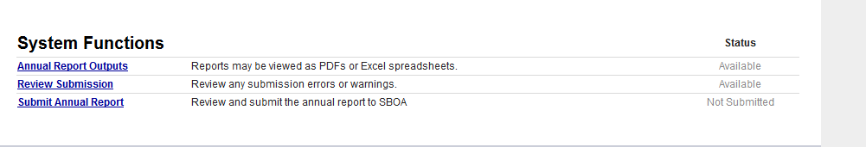
Annual Financial Report (AFR)
Submit AFR and Attestation Statement
  Don’t forget to submit. Your form is not filed until you submit it.
  An Attestation Statement is part of the submission process.

Slide 38
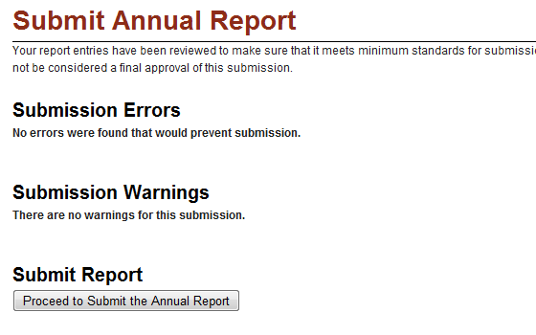
Annual Financial Report (AFR)
Submit AFR and Attestation Statement

Slide 39
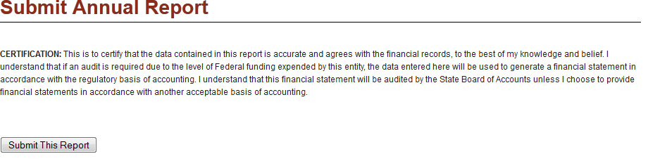
Annual Financial Report (AFR)
Submit AFR and Attestation Statement

Slide 40
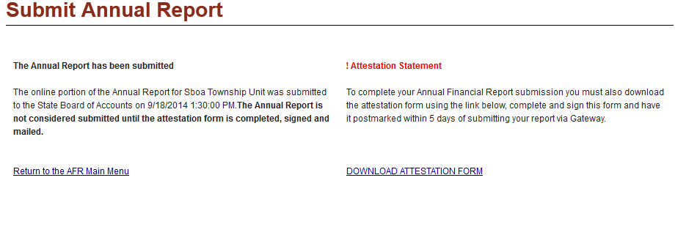
Annual Financial Report (AFR)
Submit AFR and Attestation Statement

Slide 41
Annual Financial Report (AFR)
Attestation Statement
  Certifies that the data is accurate to the best of your knowledge and belief.
  Must be signed by the official.
  Must be mailed within 5 days of submitting on Gateway.
  If you re-submit your AFR on Gateway, you must print, sign and mail a new attestation form.
  Must use the most recent version of Internet Explorer, Chrome or Firefox to view statement.

Slide 42
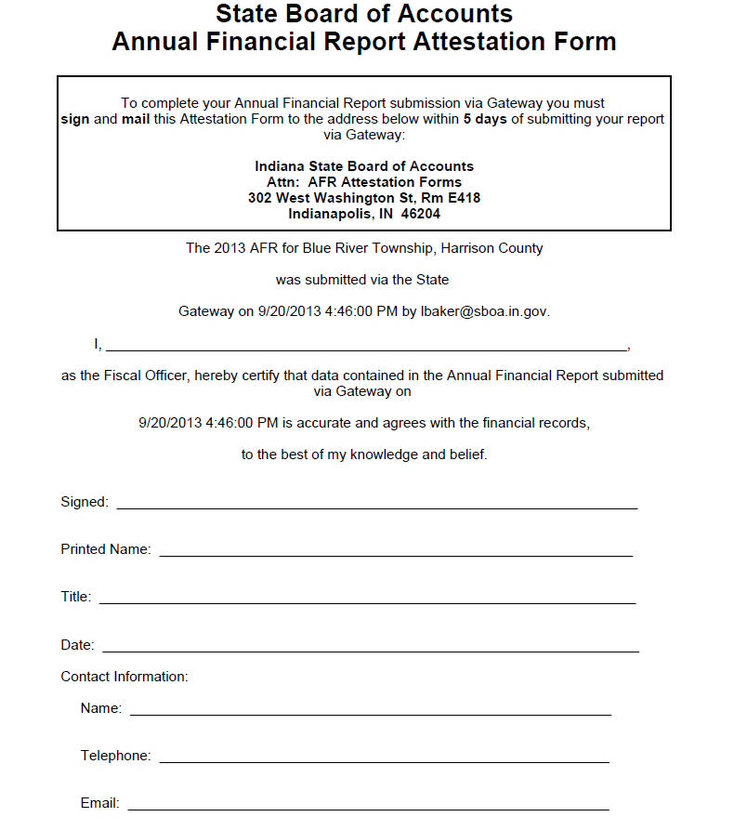

Slide 43
Annual Financial Report (AFR)
How can I get help?
  User Guide

Slide 44
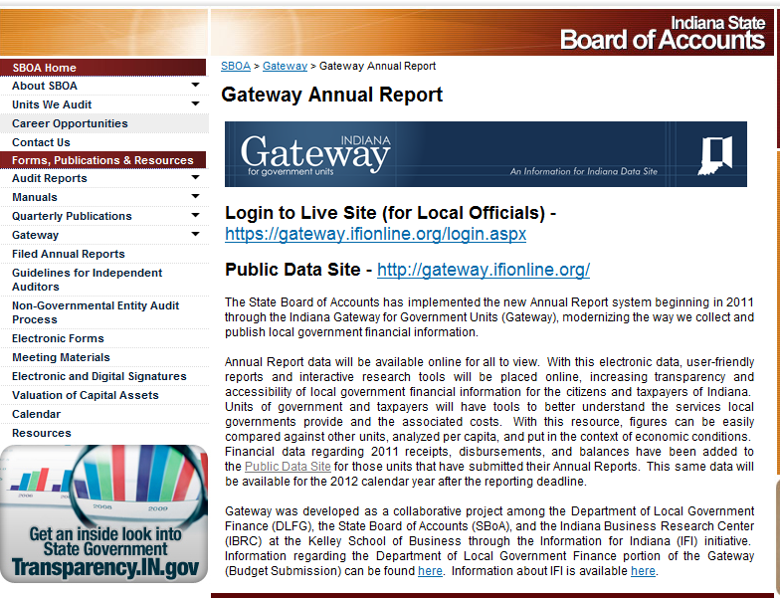
Annual Financial Report (AFR)
How can I get help?
  SBOA Web site at www.in.gov/sboa

Slide 45
Annual Financial Report (AFR)
How can I get help?
  Email the SBOA Help Desk at: annualreports@sboa.in.gov
  Email IBRC Technical Support at: ibrctech@iupui.edu

Slide 46
Annual Financial Report (AFR)
Questions?

